Slide 1
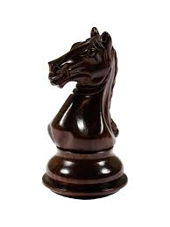
KNIGHT’s TOUR
By Sasank P
P V Sasank
13CS01007
Under the guidance of
Dr P L Bera

Slide 2
What is a Knight’s Tour problem?
A knight’s tour problem is a mathematical problem involving a knight on a chess board . The knight on the chess board is moved according to the rules of chess.
A knight's tour is a sequence of moves of a knight on a chessboard such that the knight visits every square only once.

Slide 3
A knight’s tour legal moves

Slide 4
Pictorial Representation

Slide 5
Knight’s tour can be represented as a graph.
The vertices -Represent the squares of the board.
The edges -Represent a knight’s legal moves between squares.

Slide 6
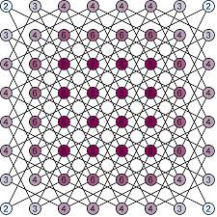
Knight’s graph

Slide 7
Types of Knight’s tour problems
There are two types of problems:
Closed
2. Open

Slide 8
Knight’s tour
Closed
Open
If knight ends on a square from which the starting square can be reached by the knight , Then that tour is a closed one.
If the beginning square cannot be reached , Then that tour is open.

Slide 9
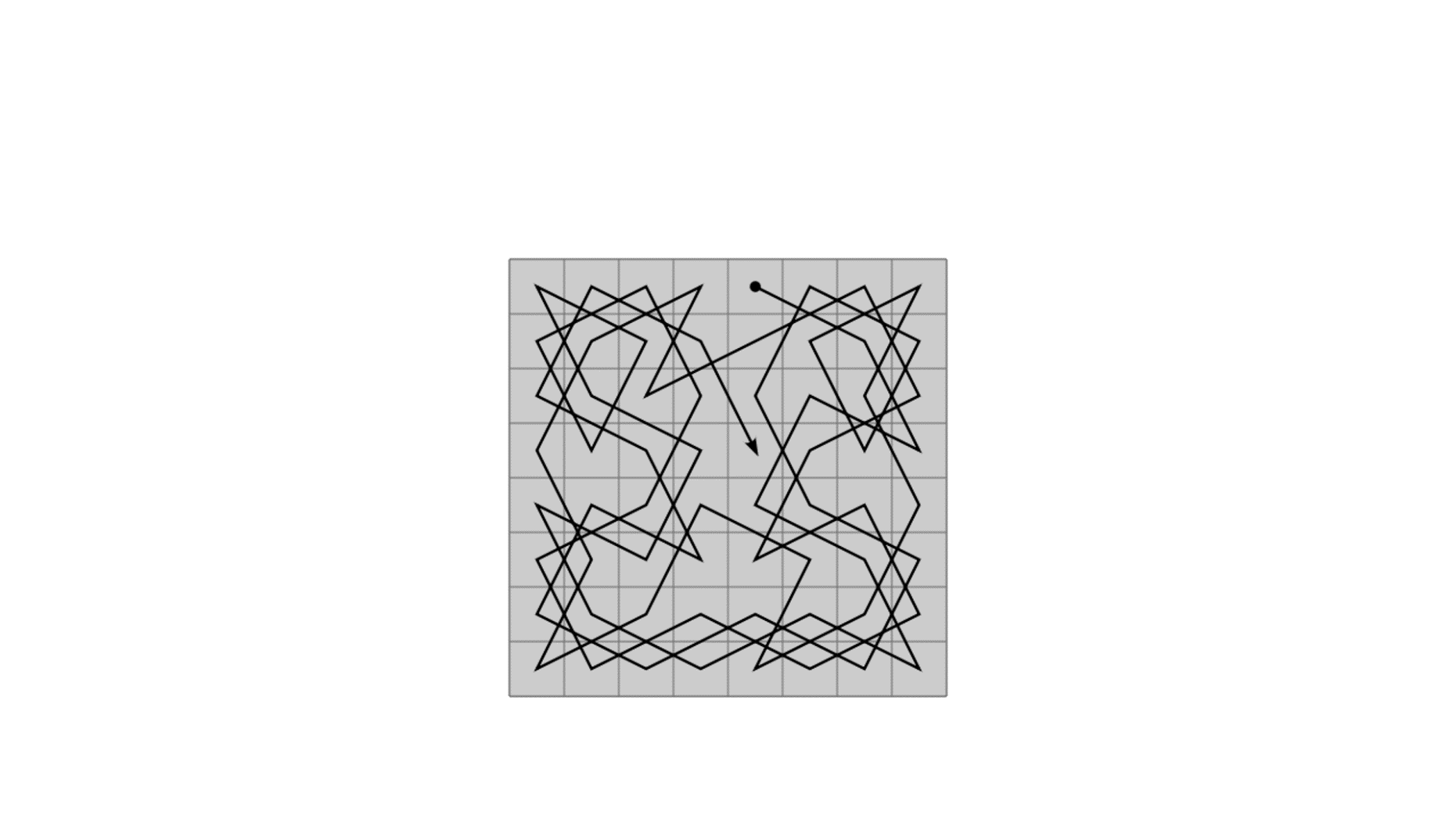
Open Knight’s tour problem

Slide 10
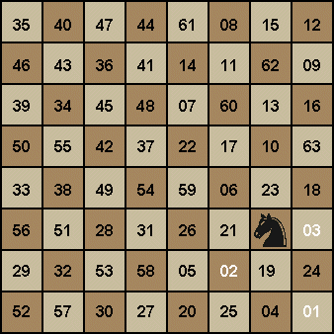
Closed Knights tour

Slide 11
Various Algorithms
Brute force search
Divide and Conquer
Warnsdorff’s rule

Slide 12
Brute force search
Very general problem solving technique.
Iterates through all possible move sequences.
For a regular 8x8 chess board, there are approximately 4×10⁵¹possible move sequences.

Slide 13


Slide 14
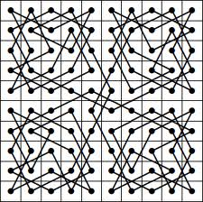
Divide and Conquer
Divide the board into smaller pieces.
Construct tours on each piece.
Patch all the pieces together.

Slide 15
Warnsdorff’s Algorithm
Introduced by H. C. Warnsdorff in 1823.
Can be solved in linear time.
Very efficient algorithm for solving knight’s tour.

Slide 16
Warnsdorff’s Algorithm
Some definitions:
A position Q is accessible from a position P if P can move to Q by a single knight's move, and Q has not yet been visited.
The accessibility of a position P is the number of positions accessible from P.
Algorithm:
set P to be a random initial position on the board
mark the board at P with the move number "1"
for each move number from 2 to the number of squares on the board:
let S be the set of positions accessible from the input position
set P to be the position in S with minimum accessibility
mark the board at P with the current move number
4.return the marked board :each square will be marked with the move number on which it is visited.

Slide 17
Warndroff’s rule Pictorially:

Slide 18
Solving Knight’s tour
2-D array of 8x8 is created to represent a chessboard.
Each element in the array is assumed to be a square on the board.
Initially all the elements are assigned to 0 , to indicate that knight has not visited any of these squares.
Shift the knight from the initial input position to anyone of the possible positions and assign the number of that move to element in that position.
If we could not find a tour , then shift the knight to any other of the possible solutions. In this way check all the positions till you find a solution.

Slide 19
C program for solving knight’s tour
..\Downloads\studies\Seminar\knights mainnew.docx

Slide 20
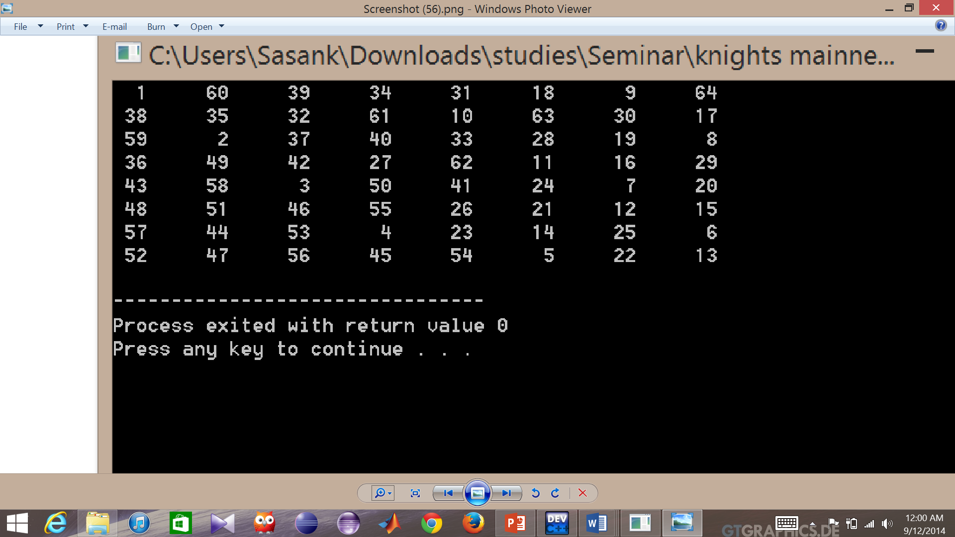
OUTPUT:

Slide 21
Solving Knight’s tour using Warnsdroff’s rule
..\Downloads\studies\Seminar\knights wandmainnew.docx

Slide 22
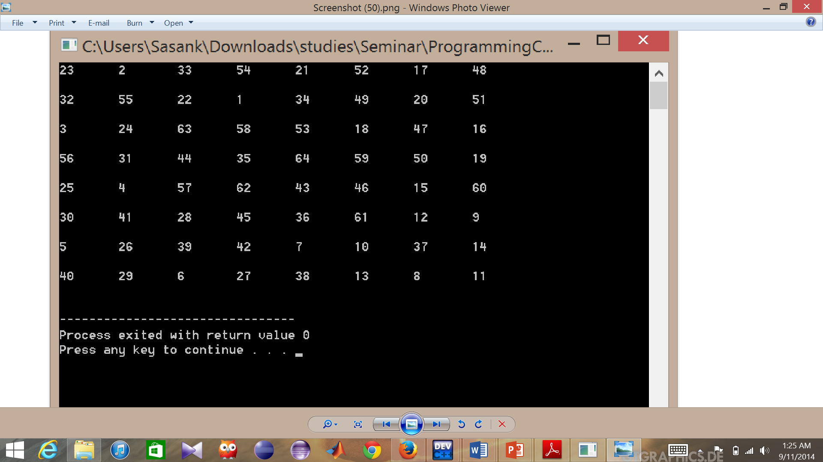
OUTPUT:

Slide 23
Interesting facts on Knight’s tour
26,534,728,821,064 closed directed knight's tours are possible on 8x8 board.
The exact number of open knight’s tours is not found yet.
It’s estimated to be about 10¹⁵ to (2*10¹⁶).

Slide 24
Magic Knight’s tour
The squares of the chess board are numbered in the order of the knight’s moves.
Full magic knight’s tour:
Each column, row, and diagonal must sum to the same number.
Magic knight’s tour:
Each column and row must sum to the same number.

Slide 26
Existence of full magic knight’s tour on 8x8 was a 150-year-old unsolved problem.
In August 5, 2003, after nearly 62 computation-days, a search showed that no 8x8 fully magic knight’s tour is possible

Slide 27
Knight’s Tours and Cryptography
A cryptotour is a puzzle in which the 64 words or syllables of a verse are printed on the squares of a chessboard and are to be read in the sequence of a knight’s tour.

Slide 28
Knight’s tour is simply an instance of Hamiltonian path.
A closed tour is a Hamiltonian cycle.
Knight's tour problem can be solved in linear time.

Slide 29
Conclusion
Warnsdroff’s rule is the best and efficient method to solve a knight’s tour.
Warnsdroff’s rule gives always a closed tour.
Proficient usage of Data structures and the user interface help us to code and understand the tour easily.

Slide 30
OUTPUT:

Slide 31
Graphical display

Slide 32
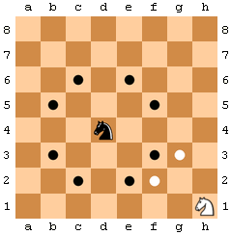
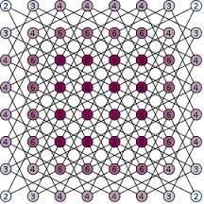

Slide 33
THANK YOU
Q&A

